Slide 1
494(P)-BAS-04: Basic Flight
Trainee Preparation
Ashilta
02 Oct 2020
02 Apr 2020

Slide 2
Lesson Overview
Air-to-Air Refuelling Principles
132nd vFW Standard Procedures
Refuelling Technique in the F/A-18C
494(P)-BAS-04

Slide 3
Air-to-Air Refuelling Principles
Purpose of Air-to-Air Refuelling
Tanker Types
494(P)-BAS-04

Slide 4
Purpose of Air-to-Air Refueling
Fighter jets are often heavily laden to accomplish a mission and consume significant amounts of fuel when manoeuvring.
In order to maximise the endurance of an aircraft without needing to return to base, tanker aircraft are staged in forward positions in order to refuel fighter aircraft.
Often, such tankers are critical in ensuring that a mission can be accomplished, or that friendly assets can remain within an area of operations for the longest possible time.
494(P)-BAS-04

Slide 5
Tanker Types
All aircraft operated by the 132nd vFW can be refuelled by variants of the KC135 ‘Stratotanker’.
The KC135, in it’s default configuration, is a ‘boom’ tanker, providing fuel by inserting a refuelling boom into a port on the recipient aircraft. Pressurised fuel is passed through the boom directly into the tank of the receiving aircraft.
The KC135 can be modified with an ‘MPRS’ or Multi-point Refuelling System kit. Refuelling pods are fitted to the wing which provide ‘drogues’ for refuelling from. A probe on the recipient aircraft is inserted into the drogue to receive fuel.
494(P)-BAS-04

Slide 6
132nd vFW Standard Procedures
Navigating to a Tanker
Contacting the Tanker
Joining on the Tanker
Tanking
After Tanking
494(P)-BAS-04

Slide 7
Navigating to a Tanker
For operations conducted by the 132nd Virtual Wing, the TACAN details for tankers will be providing in a briefing document and circulated before a mission.
The tanker can be navigated to either using the TACAN on board (with the TACAN receiver in the Hornet in A/A mode), or by requesting a ‘CUTOFF’ (intercept heading) to the tanker from a radar controller.
Whilst the TACAN will not provide altitude information for the tanker, this may be obtained from a controller, or from the Hornet’s radar.
It is required that aircraft inbound to a tanker maintain radio communications with the agency which controls the airspace the tanker is operating for as long as is practicable.
494(P)-BAS-04

Slide 8
Contacting the Tanker
When within approximately 10nm of the tanker, pilots should tune the radio frequency that the tanker is operating on and broadcast their intentions.
Where possible, communications should also be maintained with the agency for the airspace in which the tanker is operating.
Whilst operating in the vicinity of the tanker, pilots should make ‘blind’ radio calls to state their intentions – this will be covered in a later lesson.
494(P)-BAS-04

Slide 9
Joining on the Tanker
Pilots joining on a tanker should join at a level 1,000 feet below the level of the tanker. Doing so ensures separation from those already joined with the tanker whilst maximising visibility.
If the tanker is in use, pilots should join in the ‘left observation’ position.
494(P)-BAS-04

Slide 10
Joining on the Tanker
The join to this left observation position should be made safely, considering the presence of other users of the tanker.
Shortly before joining the left observation position, the flight should climb to the same altitude/FL as the tanker. Pilots should not ‘climb into’ the left observation position.
494(P)-BAS-04

Slide 11
Tanking
Once established in the left observation position, aircraft should wait until a refuelling position is free.
When able, the pilot should announce ‘MOVING PRE CONTACT’ on the Tanker’s radio frequency before moving into the ‘pre-contact’ position.
To maximise visibility of other aircraft at the tanker, the pilot should descend slightly, carefully and slowly move to the pre-contact position and climb back to the same level as the tanker.
The ‘pre-contact’ position is a position directly aft of the refuelling position.
494(P)-BAS-04

Slide 12
Tanking
When in the pre-contact position, the aircraft should transmit the ‘READY PRE-CONTACT’ message using the radio menu.
If the flight is in an acceptable position, the ‘CLEARED CONTACT’ message shall be given and the flight may refuel.
If another message is given, the pilot is likely not in an appropriate pre-contact position and should move accordingly.
494(P)-BAS-04

Slide 13
After Tanking
When tanking is complete, the aircraft should back slowly and gently away from the tanker and stow the refuelling probe.
Descending out of the formation slightly again, the aircraft should move to the ‘reform position’ on the right side of the tanker. This mirrors the ‘left observation’ position, but is simply on the right side of the tanker.
Once a desirable position has been reached, the aircraft should climb back into the formation until they are ready to push away from the tanker.
When ready, pilots should announce ‘PUSHING AWAY’ on the tanker’s radio frequency and safely depart the formation.
494(P)-BAS-04

Slide 14
Tanking Technique
Joining Technique
Contact Technique
494(P)-BAS-04

Slide 15
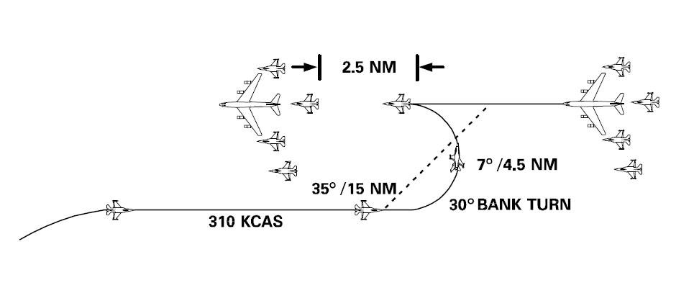
Joining Technique
The F/A-18C is a high performance fighter, whereas the KC135 is a large, encumbered jet.
Accordingly, great care and attention should be taken whilst joining a tanker for the purposes of refuelling.
For high-aspect rendezvous, the ‘fighter turn on’ can be used and is depicted below:
494(P)-BAS-04

Slide 16
Joining Technique
The fighter turn on is achieved by:
Flying towards the tanker on parallel, opposing track. This track should be displaced from the tanker’s track.
Set the aircraft’s speed to 310 knots.
When the tanker passes either 35 degrees left or right of the nose, commence a 30 degree turn towards the tanker.
Using the throttle and being careful to not pull back on the stick, maintain speed throughout the turn.
Having turned through 180 degrees, the aircraft should be approximately 2.5nm in trail of the tanker.
494(P)-BAS-04

Slide 17
Joining Technique
In the final stages of the joining process, the aircraft’s speed should be gradually reduced, with small, early inputs being most appropriate.
The use of the speedbrake should be avoided, unless in an emergency.
The climb from 1,000 feet below the tankers level to a level equivalent to the tanker should be gradually and carefully completed.
Movements from the left observation position to the pre-contact, contact and reform positions should be conducted slowly and with a good lookout, providing regard to other aircraft around the tanker.
494(P)-BAS-04

Slide 18
Contact Technique
The F/A-18C uses a ‘probe and drogue’ system, whereby the refuelling ‘probe’ is on the aircraft itself and the probe is inserted into a drogue or ‘basket’ to obtain fuel.
The drogue is attached to the tanker by a hose – accordingly, the hose is susceptible to the effects of airflow and its’ position relative to the tanker is not fixed.
On this basis, many Hornet pilots are guilty of ‘chasing the basket’ – making a series of rapid inputs to try to place the probe into the basket, or to keep it there once contact has been established.
494(P)-BAS-04

Slide 19
Contact Technique
Once contact is made, the probe and drogue remain attached unless significant forces act to part them, i.e. the receiving aircraft not maintaining enough speed and ‘falling out’ of the basket.
To maintain contact, Hornet pilots should fly in formation with the tanker. The reduced control inputs will ensure that the probe remains connected throughout.
For the purposes of remaining connected, the Hornet should be placed directly aft of the refuelling pod. The pod itself should be placed between the two lines denoting a 10 degree climb in the HUD.
494(P)-BAS-04

Slide 20
Contact Technique
Whilst the ATC system may be used to maintain speed and assist in staying connected, it is difficult to capture precisely the correct speed for this purpose.
Manual control should be maintained, with many, small inputs being made rather than a number of gross movements in the throttle range.
Whilst in contact, the speedbrake must not be used.
494(P)-BAS-04

